Slide 1
Biodiversity in US National Parks
Tiia Jacklin / Codecademy project
26 Nov 2025

Slide 2
Data used
species_info.csv
  Includes the category of the species (Mammal, Amphibian, …), scientific name, common name and conservation status
observations.csv
  Includes the scientific name, park name and the number of observations (in a week)

Slide 3
What was checked and why?
Distributions of observations per species by conservation status
  Are endangered species observed less?
Top species by share of observations in each park
  Are the same species observed equally much in each national park?
Number of species per 100 observations in each park
  Is the biodiversity between the parks the same?
Number of observations per major taxonomic group in each park
  What kinds of species are observed the most?
Share or rare/endangered species from total observations in each park
  How large portion of observations is of the species with a conservation status?

Slide 4
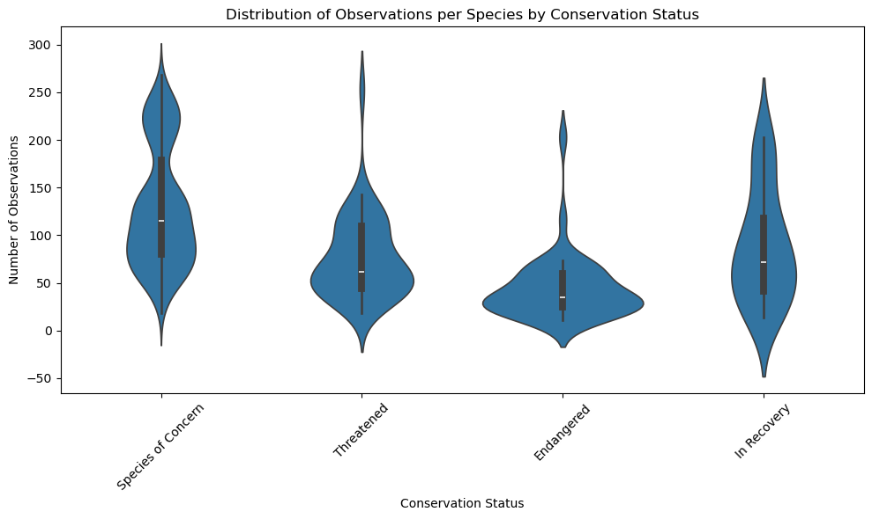
Average number of observations from smallest to largest: Endangered -> Threatened -> In recovery -> Species of Concern
The distribution of number of observations for the species “In recovery” is much better than for “Endangered”, this means the recovery efforts are not going to waste.

Slide 5
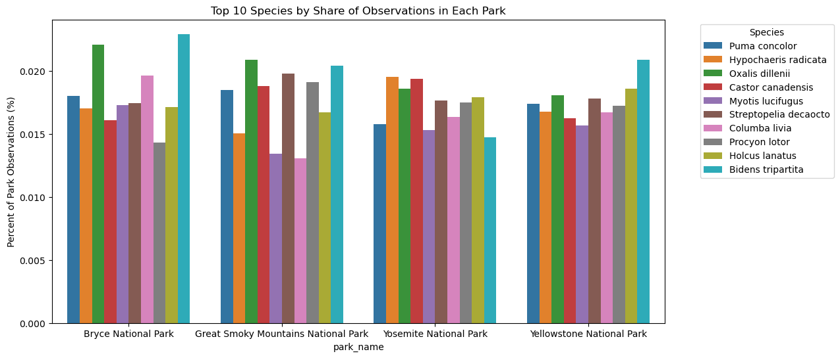
No observable trends between the national parks for the ten most observed species
All species have only a small share of total observations -> wide variety of observed species

Slide 6
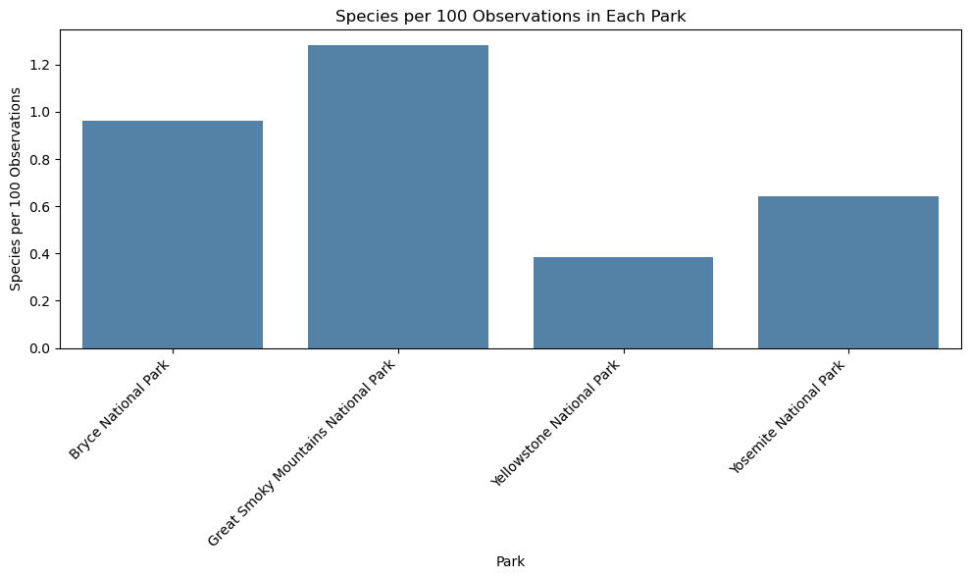
Differences in species per 100 observations, but no differences in total observed species
More species per 100 observations -> smaller populations (and vice versa)

Slide 7
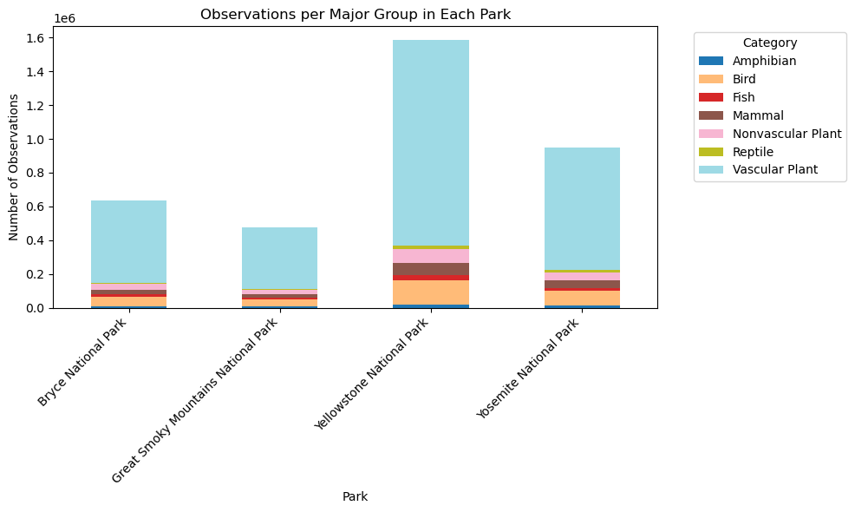
Vascular plants have by far the most observations of all groups in all national parks
Next largest category is birds
Smallest category seems to be reptiles (in all parks)

Slide 8
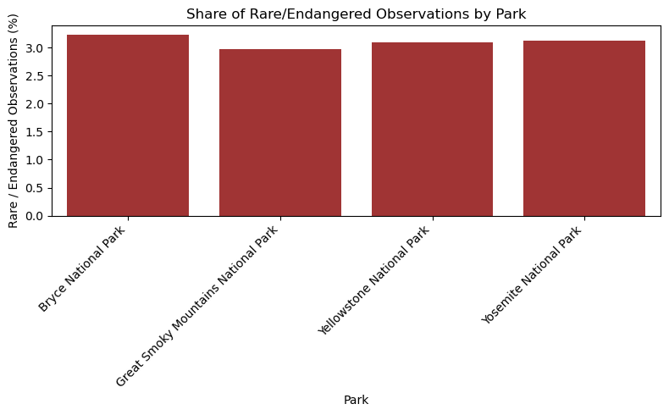
No large differences in the share of rare and endangered species from the total observations
Slightly higher for Bryce National Park (3.23%), lowest for Great Smoky Mountains National Park (2.97%)

Slide 9
Conclusions
All the species included in the observations are observed in every national park
None of them have a high percentage from total observations
There are some differences between the observations in the parks, but no clear trends
Major groups of species observed the most in every park are vascular plants, whereas the least observed major group are reptiles
The conservation statuses accurately describe the averages of the species populations and indicate successful recovery efforts for species in “In recovery” category

